Slide 1
Work Overview
B&SR, Oncology India
Mumbai
January 2007

Slide 2
Agenda
Background :
    NICCI now B&SR Onc, India
    Transition
2006 Work summary
    Phase II/III studies
    Phase I/CP studies
    Non-Clinical/Mentorship
What is working/not working ?

Slide 3
Agenda
Background :
    NICCI now B&SR Onc, India
    Transition
2006 Work summary (Productivity) :
    Phase II/III studies
    Phase I/CP studies
    Non-Clinical/Mentorship
    Quality
What is working/not working ?

Slide 4
Background : NICCI now B&SR Onc, India
Oncology TA
Projects supported from 2002 to 2005 :
Years
Projects
2002
2003
2004
2005
EPO
Colon
Blood cancer
STI
RAD
Z
OL
Bone metastasis
Thalassemia
ICL
PTK
Colorectal cancer
Solid tumor
XAA
LBH
Blood cancer
AMN
Blood cancer
Brain tumor
AEE
No. of programmers 6 5 5 5
Phase 2-3 studies
Phase 1 studies Starting in 2003.

Slide 5
What do we do ?
We support
    Clinical Study Report (CSR) Safety Reporting
    Summary of Clinical Safety (SCS)
    Standardization initiatives
    Health Authority questions
    Ad Hoc / Publication
    Investigator brochures / Briefing Books (The Investigators’ Brochure (IB) is a compilation of the clinical and non-clinical data about an investigational drug or product that is relevant to its study in humans.)

Slide 6
Background : Transition from TA to BU
Transition :
    January 2006, simultaneously as was done at other sites
    Support from the B&SR, India and Global managers
      Lira and Nikita, locally
      Lixia and David, from USA
    Seamless transfer of work
      Work allocation through PP‘s as was in Central B&SR
      All the SOPs and WPs as in Central B&SR

Slide 7
Agenda
Background :
    Ex – NICCI now B&SR Onc, India
    People
    Transition
2006 Work summary
    Phase II/III studies
    Phase I/CP studies
    Non-Clinical/Mentorship
What is working/not working ?

Slide 8
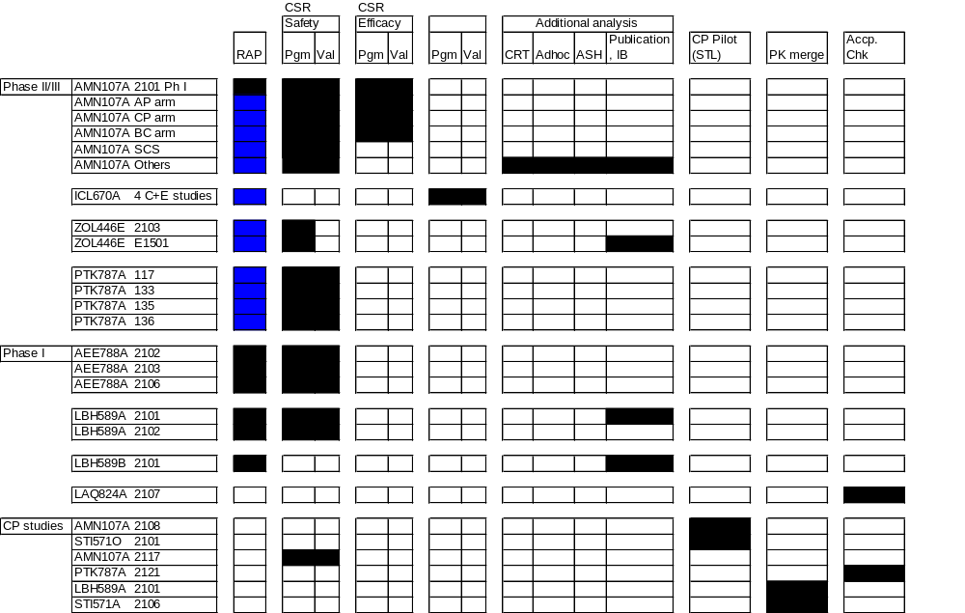


2006 Work Summary, Clinical Projects :
Inputs Work done

Slide 9
2006 Work Summary, Clinical Projects :
 | Target | Actual ‘06
Study Level work
New studies in 2006: |  | 7.4
Complete (100% considered) |  | 5.0
Dry run (70% considered) |  | 1.4
Ongoing (50% considered) |  | 1.0
Study level DSMBs/Interim Analysis |  | 0.0
Carryover studies from 2005: |  | 3.4
Post dry run (30% considered) |  | 0.9
Ongoing (50% considered) |  | 2.5
Project Level work |  | 2.5
SCS/DSMB/Interim Analysis/120 Day update/IB support/ED-pilot study/pooling |  | 2.0
Project level publication, HA questions |  | 0.5
Other work |  | 2.8
Validation of study level interim analysis/AMN SCS (79.9 WDs/42 = 1.90 studies) |  | 1.9
SAR PK, PK merge, Japan trainings (35 WDs/42 = 0.83 studies) |  | 0.8
Acceptance check (4.0 WDs/42 = 0.1 studies) |  | 0.1
Study Level HA requests/Publication support (0 WDs/42 = 0 studies) |  | 0.0
Total studies | 16 | 16.1 (100% vs 100% target for the period)

Slide 10
2006 Work Summary, Non-Clinical Projects :
  Non-Clinical projects :
    STL Superuser
    GPS II Superuser
    SAS Migration
    SAR – PK
    SR Process Review
    Oncology Recruitment
    IT co-ordination
  Trainings :
    CP training
    Mentorship
    New Hire training

Slide 11
Agenda
Background :
    Ex – NICCI now B&SR Onc, India
    People
    Transition
2006 Work summary
    Phase II/III studies
    Phase I/CP studies
    Non-Clinical/Mentorship
What is working/not working ?

Slide 12
What is working & what is not ? :
  Planning of work
    Criticality of work / Changing Priorities
    Adhoc requests
    Resource Allocation and Project Plan
  Communication
    Within the team (TP, PP, TS and PS)
    Escalation of issues
  Time difference
  Attrition
    Globally, a lot of open positions,
    In-expereienced programmers (Globally/Locally)
  Processes
    RAP (Programming, validation)
    SOP/WP (e.g. GPS II, CREDI)

